Slide 1
Business Intelligence Application
Prepared by: Saja Abdulazeez, 20110060
(check foot notes for further clarification)

Slide 2
What is Business Intelligence?
In 1958, the term ‘Business Intelligence’ was coined by IBM researcher Hans Peter Luhn.
Simply put, BI is the “collection, management, analysis, and reporting of data”,
Its main objectives are to extract insights from company data, facilitate business data analytics and enhance communication through data visualization.
All aimed towards supporting businesses through data driven decision making.
Notes:
[1] Evans, J.R. (2016). Business analytics : methods, models, and decisions. Boston: Pearson.
[2] Jaspersoft. (2023). What is Business Intelligence (BI)? [online] Available at: https://www.jaspersoft.com/articles/what-is-business-intelligence.

Slide 3
BI Tools and Techniques
Some famous BI tools include Microsoft Power BI, Tableau and QlikSense
These tools facilitate business intelligence, i.e., the analysis, mining, visualizing and reporting of company data to gain valuable business insights that aid decision making
Main business intelligence techniques include:
Data visualization
Data mining
Querying
Predictive analytics
Notes:
Data visualization: one of the selling points of BI is the data visualization capabilities, transforming tabular data to visuals that aid those with no background in IT or data analysts to detect patterns and hidden insights in data that can later be taken into account when performing business decisions.
Data mining : includes Extract-Transform-Load (ETL) to transform data from multiple sources and storing in data warehouse for further analysis, extracting correlations, patterns and insights from data. BI allow to streamline this process given massive data sets that would regularly take users a lot of time and effort to get done with traditional tools
Querying : “Database queries are request for information” BI tools allow users to connect to data repositories, with well written queries its simpler to obtain accurate information to enable data visualization
Predictive analytics: utilizing BI with ML or AI can aid companies in identifying and predicting likely outcomes so they can be prepared for best and worst case scenarios
Reporting can be in the form of dashboards, KPIs utilizing descriptive analytics to summarize and monitor trends across the business annually or quarterly
Provided the LinkedIn data set, the dashboards were created using Microsoft Power BI in an aim to find business insights discussed further into the presentation
[3] Indeed Editorial Team (2024). What Is Business Intelligence? (With Techniques and Uses). [online] Indeed Career Guide. Available at: https://in.indeed.com/career-advice/career-development/what-is-business-intelligence.

Slide 4
BI tools and decision making – Uber
Uber, a popular transportation company, leverages BI for data driven decision making, streaming operations and enhancing customer experience
Real-time data monitoring
Real-time traffic condition updates
Track drivers' availability, for quicker response time to ride requests
Analyze patterns in customer demand predicting high traffic times
Journey durations for estimating ride fairs
Hence a surge in prices during rush hours and high demand periods.
Uber harbored many users, drivers and customers alike, allowing them to benchmark in the cab rental markets
BI operations (data driven decision making) also aided Uber to expand into food delivery and pickup services
Notes:
Using BI tools enabled Uber to gain valuable insights from real time data, leading to numerous benefits. BI tools allowed uber to act swiftly on real time insights, enhancing efficiency and performance. Resulting in an increased customer satisfaction, higher profits and most importantly the ability to make informed data driven decisions that align with their business goals and strategies.
[4] Mohammed, M. (2024). 15 Real World Business Intelligence Examples. [online] www.knowledgehut.com. Available at: https://www.knowledgehut.com/blog/business-intelligence-and-visualization/business-intelligence-examples.
[5] Tikait, P. (2022). Business Intelligence Examples | 2022 Comprehensive Guide. [online] SelectHub. Available at: https://www.selecthub.com/business-intelligence/business-intelligence-examples/.

Slide 5
Preprocessing on LinkedIn Dataset
The Excel file consisted of 4 different sheets:
Companies: information about each company, which region its size and more
Employee counts: companies and their corresponding number of employees and followers on LinkedIn
Job postings: information about each job post created by companies to gather applies
Job skills: the skills look for corresponding to each job ID
The data set presented many nulls and repeated values
Some columns containing only values of ‘1’ or ‘null’; I replaced the nulls with 0
Columns such as ‘description’ and those with more than half their values as null were dropped
The ‘time_recorded’ column presented in the form ‘1692644644’
It was later discovered that they all lead back to 21/08/2023 7:04:04 PM
Not much use was gained out of the time stamps
Made sure the data sets had correct cardinalities and relationships given the shared primary key of ‘company id’

Slide 6
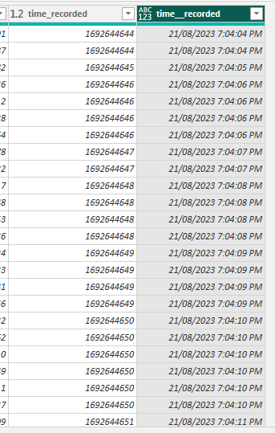
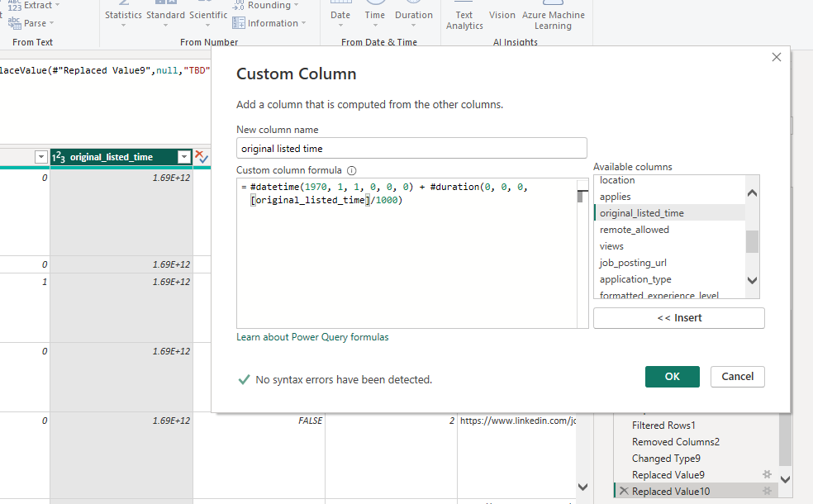
Preprocessing with Power Query – transforming timestamps with add custom column on ‘employee_counts’ and ‘job_postings’
Notes:
From Microsoft community: https://community.fabric.microsoft.com/t5/Desktop/Converting-UNIX-time-to-Date-in-PowerBI-for-Desktop/m-p/130951

Slide 7
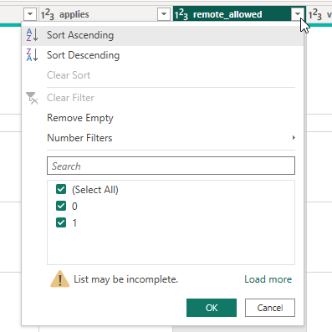
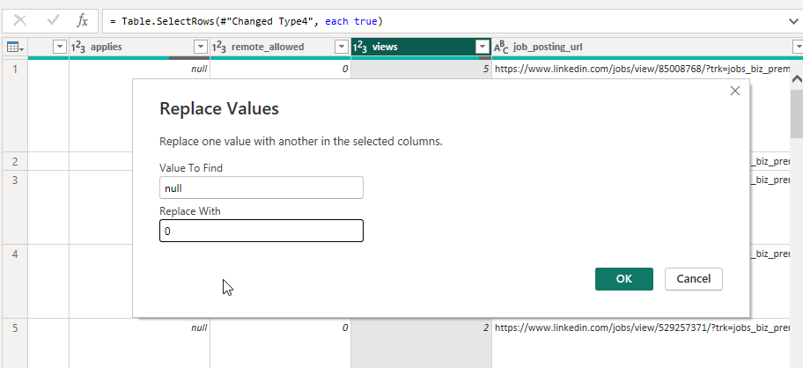
Preprocessing with Power Query – replace values

Slide 8
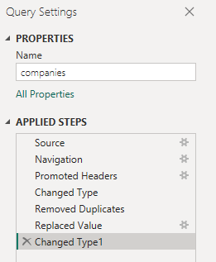
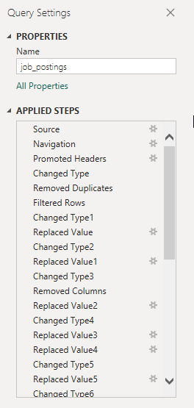
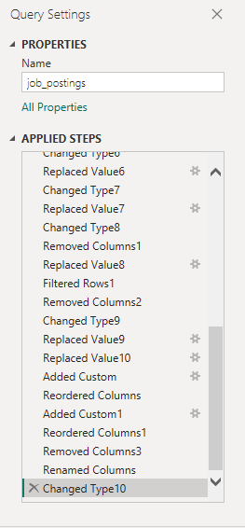
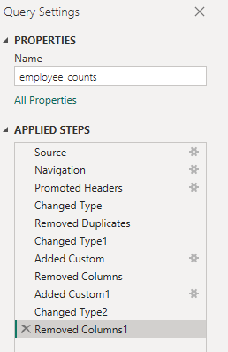
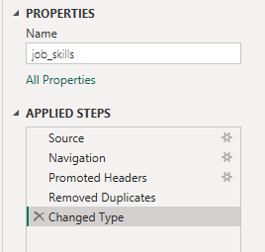
Preprocessing with Power Query – Applied steps
Notes:
The data set that took the most work was job posting
Removed duplicates was for the company and job IDs (unique values)
To make my life easier, I changed the data type for primary keys (among others) as alphabetical so the visualizations can be as categorical
For eg: the company size from 1-7 categorizes each company as either a 1-7 figure company meaning it can generate from $1 (1 fig)- $1,000,000 (7 figs) annually
From: https://www.linkedin.com/pulse/difference-between-6-7-figure-business-its-what-you-think-tyler-basu/
The columns that were removed had more than half as null, this could be when filling information about the company some information was optional hence the nulls
The added custom, reordered, renamed and removed columns was for after adjusting the time stamps

Slide 9
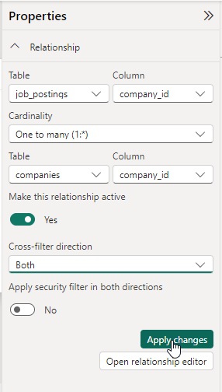
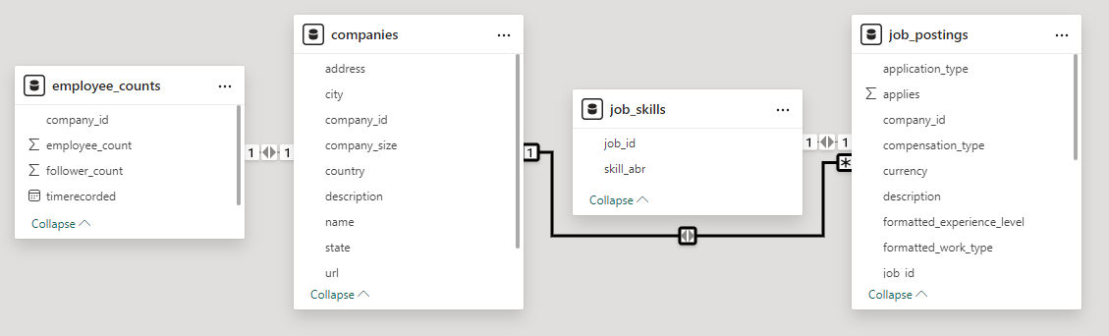
Cardinality – Model View
Notes:
The new relationship established between companies and job postings was set as one to many because one company can have multiple job postings; this was the only one I had to add manually (the bold line) the rest were set from within the data set, this step allowed for better visualization where I could show the name of the company rather than ID, as well as calibrate the countries so I can add legend from any data set

Slide 10
Dashboards & Visualizations

Slide 11
Questions to lead with – as a LinkedIn DA
What regions utilize LinkedIn for job postings the most?
What skills are most sought after in job posts?
Does a higher employee count indicate a higher follower count for companies?
Does company size affect the average salaries offered?
Which companies utilize sponsored content on LinkedIn?
Do sponsored job posts receive more applies and views?
Which companies post jobs more frequently?
What type of experience do most companies look for in candidates?

Slide 12
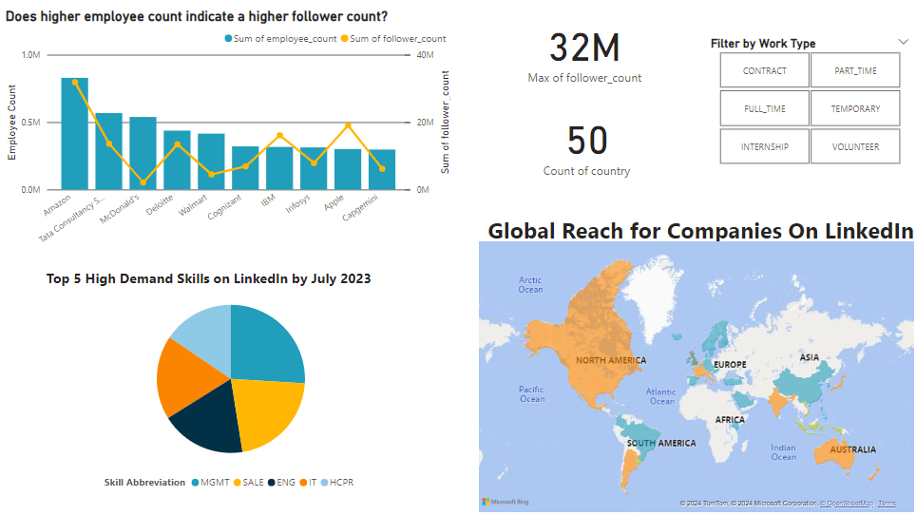
1st Dashboard – Companies, Employees and Skills Datasets
Notes:
(the visualizations are explained in detail in the next slides)
Made use of PowerBI main features such as:
Filters
Bar chart: To get the top 10 companies for employee count
Pie chart: for top 5 skills that are not ‘OTHR’
On all to not = ‘Blank’ or 0
Clear titles
A uniform color pallet
All in favor of a user-friendly interactive design
Overall, this dashboard shows us where majority of company profiles on LinkedIn are located, in 50 countries total
The bar chart shows us the top 10 companies with highest employee count, additionally the line shows us the follower count → main question here was does a higher number of employees account for a higher number of followers? We see that the answer was ‘not necessarily’
We see here amazon had the highest number of employees and followers given how large the company is
The card visualization of max number of followers count shows that Amazon’s LinkedIn account has gathered 32M followers
The pie chart is an indicator for the most sought-after skills taken from ‘job skills’, each corresponding to a ‘job id’ from ‘job postings’, we see the top 5 skills in job postings are in the sectors of: management, sales, engineering, IT, and health care provider resuscitation
The filter by work type are buttons making it straight forward and easier for the user viewing the interactive dashboard (filters on the next slide)

Slide 13
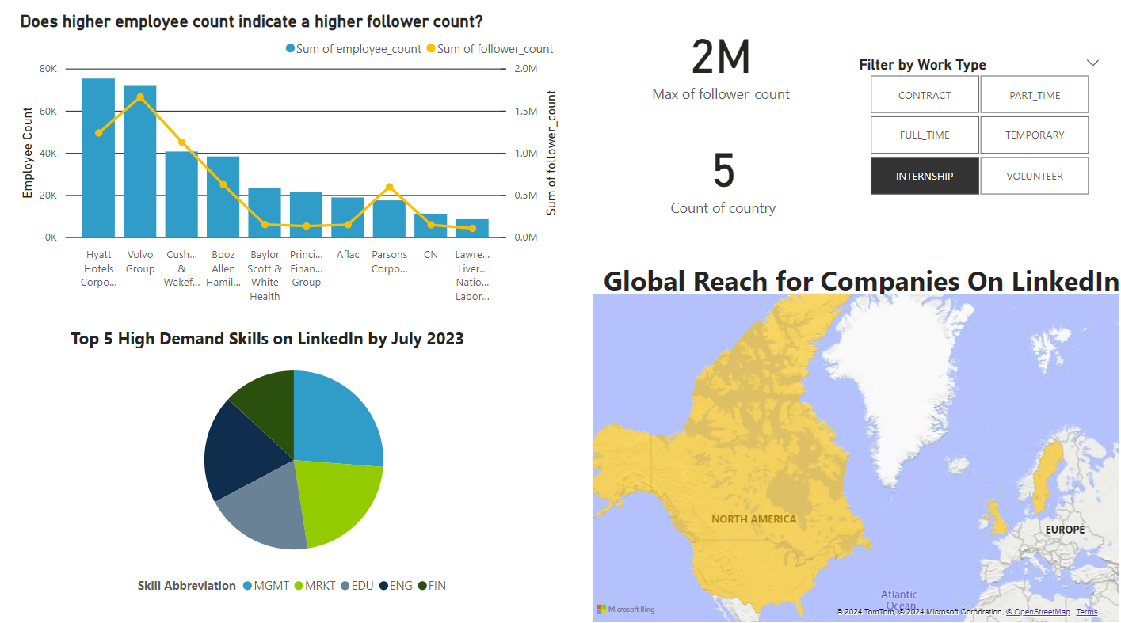
1st Dashboard – Filtered on work type ‘Internship’
Notes:
This is a dashboard filtered by work type using the slicer → Internship
We can come to the conclusion that 5 countries mainly offer internships, the top 3 companies offering most internships are Hyatt Hotels Corporations, Volvo Group and Cushman & Wakefield, these internships are mainly in management, marketing, education, engineering and finance
This dashboard allows us to further understand what the data set contains, given the 4 sheets, and rather than going through them table by table; power BI allowed us to visualize these relationships interactively with filters. Making a more personalized dashboard catered to the needs of the viewer which most of the time are those with little to no background in IT

Slide 14
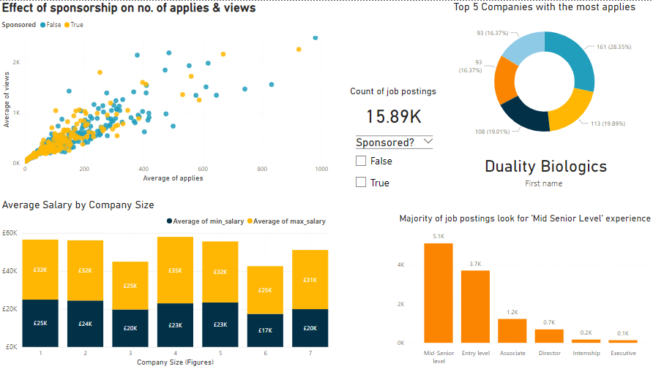
2nd Dashboard – Job Postings
Notes:
This dataset revealed many insights, main objective here is to see what percentage of companies on linked actually use sponsorship and if they do, does it affect the number of applies?
Design principles I adhered to in order to make this dashboard user friendly for strategic / tactical managers
Consistent color pallet to reduce visual clutter
Card visuals to further highlight critical information such as company name and number of sponsored job posts
Slicer allows user to easily differentiate between sponsored and not sponsored posts
Clear titles for each visualization for easier navigation and understand the purpose of each visual
The visualizations translate to the following:
The card with the company name shows the first name of the company with most applies, this changes based on the applied filters in interactions
The ‘Sponsored?’ slicer placed in the middle of the page gives the user the chance to see what companies sponsor their job posts
The scatter plot on effect of sponsorship on number of applies and views; I mainly wanted to explore if a relationship exists between number of applies and views (obviously yes but to see if the data set is correct in that sense as well) it is filtered by sponsored posts and no..to view if sponsoring posting aid in getting higher views and applies
The card of ‘count of sponsored posts’ changes with the filters (initially with no filters it’s the total number of job posts)
The average salary by company size was to see if companies in larger sizes offer higher max and min salaries, we see that’s not necessarily the case, but this could be skewed because of many nulls in the data set
The last bar chart, shows that 5.1k of 15k job postings look for ‘Mid Senior Level’ experience and only 0.1k for executive which makes a lot of sense since choosing to employ someone in an executive position is usually a very thought-out process and are usually selected not hired through resumes

Slide 15
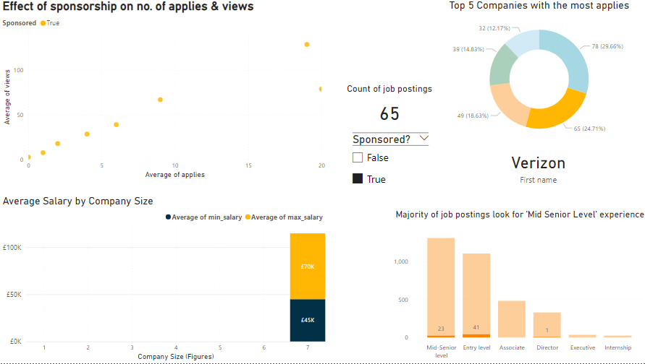
2nd Dashboard –Sponsored postings by Verizon
Notes:
Here, I chose the filter of True → only sponsored job posts and then chose the company Verizon from the pie chart
We see that Verizon has posted 65 sponsored post from a total of 113
Majority of these posts were looking for entry level experience (41 of 65 posts were entry level)
Verizon is a Seven figure company that, on average, offers a minimum salary of 45k and a max salary 70k
This dashboard allowed us to gain further insights on companies that utilize sponsoring job posts
What action can be taken as a business (LinkedIn) with these insights?
For example, we could:
create and push a tailored campaign for Verizon, enhancing their use experience and their loyalty to posting on LinkedIn rather than other competitor companies
looking into other companies we could expand LinkedIn audience to broaden the use of sponsorship
Launch targeted advertising to Verizon and similar companies

Slide 16
Security Issues in BI
First and most importantly is establishing a level of trust between customers and companies; customer loyalty is pivotal
Today, massive amounts of personal sensitive data are utilized by companies, whether in the private or public sector
This presents some security issues such as:
Poor access control: ineffective management of access to sensitive data leading to data breaches
Security flaws in BI applications: vulnerabilities in BI tools can be exploited by attackers
Insider threats: malicious employees or those unaware of security protocols when handling data
Notes:
[6] Virtux BI Solutions (2023). Cybersecurity Threats in the Age of Business Intelligence. [online] www.linkedin.com. Available at: https://www.linkedin.com/pulse/cybersecurity-threats-age-business-intelligence-techmythrabi/.
[7] Smallcombe, M. (2021). Why Business Intelligence Is a Security Risk. [online] Integrate.io. Available at: https://www.integrate.io/blog/business-intelligence-is-a-security-risk/.

Slide 17
Security Measures & Regulations Compliance
Data privacy and security: companies must comply with data protection laws such as the GDPR in the EU or the PDPL in Jordan and implement robust measures and standard practices throughout the company to safeguard data against malicious activities.
Regulatory Compliance: adhering with industry specific regulations such as HIPAA for health care or SOX for finance in the US. TRC for telecom in Jordan or central bank of Jordan regulation for finance.
Access control: unauthorized access and misuse of data can lead to liabilities, penalties and deteriorate company reputation hence, companies must place monitoring and multi-factor authorization to add an extra layer of security and preventing misuse of data.
Notes:
Jordan has introduced it personal data protection laws (PDPL), like the EU GDPR, where companies must comply with specific safety measures and practices to ensure customer security and privacy in an effort to protect the customer from companies exploiting data for personal gain or selling customer data to 3rd parties
Two more points:
Transparency and communication: companies must always transparently communicate to the customer and general public how their data is being used with BI tools.
Intellectual property (IP) rights: business utilizing data from outside the company must ensure data source is safe, is trusted and contains licensing agreements to make sure all actions are legal and to avoid infringement such as penalties or legal hearings
Companies can always reach out to third party legal offices or hire a law team to work hand in hand with data governance / management teams to ensure all measures of precaution are adhered to (next slide…what is data governance?)
[8] admin (2023). 8 Legal Issues for Business Intelligence Tools: Expert Insight. [online] Apexcare Medigenix. Available at: https://apexmedigenix.com/8-legal-issues-for-business-intelligence-tools-expert-insight/.

Slide 18
BI and Data Governance
Companies today are understanding the value their data holds, rather than archiving and keeping data in servers collecting dust over time, companies today can leverage numerous tools, free or paid, to mine this data, prepare it for analytics and visualization
Through these processes they can earn new perspective on their day-to-day actions, revealing hidden patterns and insights that other wise could not have been revealed
Working hand in hand with legal and ethical practices, companies today can take their first steps into data governance → transforming data into a valuable resource while adhering to ethical practices and secure operations

Slide 19
Orange Telecom and Arab Bank Data Governance Practices
In an interview conducted with Orange’s data governance leader and Arab Bank’s lead AI engineer pointed out how data governance and management of company and customer data enabled the following practices:
Streamlined Data Processing: Enhanced efficiency in managing company data.
Customer behavior analysis: Used KPIs and reporting to uncover customer behavior patterns based on data consumption.
Data-driven decision making: Enabled decisions based on analyzed data patterns.
tailored campaigns and rewards: Created targeted campaigns and personalized rewards, enhancing customer loyalty through tailored offerings.
predictive analytics: Predicted customer churn and assessing risk scores to mitigate potential issues.
Notes:
We can take this information into account given how large these two companies have gotten in Jordan, Orange has generated almost JOD 360.7 million in 2023.
Arab bank on the hand is highly known for their customer centric and data driven approach, generating JOD 3,150 million in 2023
The information on orange is taken from my CRP proposal titled ‘Compliance Challenges with Personal Data Protection Laws in Big Data-Driven Fintech’ from last semester, interviews were conducted around January 2024
Numbers from:
[9] https://orange.jo/sites/default/files/documents/Annual%20Report%202023.pdf
[10] https://www.arabbank.com/mainmenu/home/investor-relations/face-sheet

Slide 20
References
[1] Evans, J.R. (2016). Business analytics : methods, models, and decisions. Boston: Pearson.
[2] Jaspersoft. (2023). What is Business Intelligence (BI)? [online] Available at: https://www.jaspersoft.com/articles/what-is-business-intelligence.
[3] Indeed Editorial Team (2024). What Is Business Intelligence? (With Techniques and Uses). [online] Indeed Career Guide. Available at: https://in.indeed.com/career-advice/career-development/what-is-business-intelligence.
[4] Mohammed, M. (2024). 15 Real World Business Intelligence Examples. [online] www.knowledgehut.com. Available at: https://www.knowledgehut.com/blog/business-intelligence-and-visualization/business-intelligence-examples.
[5] Tikait, P. (2022). Business Intelligence Examples | 2022 Comprehensive Guide. [online] SelectHub. Available at: https://www.selecthub.com/business-intelligence/business-intelligence-examples/.
[6] Virtux BI Solutions (2023). Cybersecurity Threats in the Age of Business Intelligence. [online] www.linkedin.com. Available at: https://www.linkedin.com/pulse/cybersecurity-threats-age-business-intelligence-techmythrabi/.
[7] Smallcombe, M. (2021). Why Business Intelligence Is a Security Risk. [online] Integrate.io. Available at: https://www.integrate.io/blog/business-intelligence-is-a-security-risk/.
[8] admin (2023). 8 Legal Issues for Business Intelligence Tools: Expert Insight. [online] Apexcare Medigenix. Available at: https://apexmedigenix.com/8-legal-issues-for-business-intelligence-tools-expert-insight/.
[9] https://orange.jo/sites/default/files/documents/Annual Report 2023.pdf
[10] https://www.arabbank.com/mainmenu/home/investor-relations/face-sheet

